Slide 1
Workshop to Raise Awareness of PREVENT.
Facilitator - David Chadwick
Number: 9744704

Slide 2
CONTEST
Pursue:
Stop terrorist attacks
Reduce Threat
Prepare:
Mitigate the impact of a terrorist attack
Reduce
Risk
Protect:
Strengthen our protection
against terrorist attacks
Reduce Vulnerability
Prevent:
Stop people from becoming
terrorists or supporting terrorism

Slide 3
WHAT IS PREVENT?
Safeguarding vulnerable people from radicalisation is no different from safeguarding them from other forms of harm’
‘

Slide 4
KEY LEGISLATION & GUIDANCE
DfE British Values Guidance - November 2014
Independent School Standards - January 2015
OFSTED Inspection Handbook - August 2015
Counter-Extremism Strategy - October 2015
Keeping Children Safe in Education - September 2019 (Recent update)
Counter Terrorism and Security Act 2015
Prevent Duty puts engagement with the Prevent programme on a statutory footing.
Gives certain bodies a new duty to have ‘due regard to the need to prevent people from being drawn into terrorism’.
Prevent should be seen in the context of your existing ‘duty of care’

Slide 5
CURRENT THREATS
Al-Muhajiroun , a proscribed Terrorist organisation is active
in Walsall..
The Identitarian movement (Formerly GI)
Whilst ISIL has lost its stronghold there are still those that agree with its ideology. This could cause a spike in:
A call for people to fight and to rebuild their so called Islamic state.
Most likely destinations are Somalia, Yemen.
‘Lone Actor’ attacks – Including that from the far right. Attack in
Christchurch has caused a rise in violence with several mosques being
attacked locally. This could cause distress and worry for many
as we approach Ramadan.

Slide 6
WILL THE RECENT DEATH OF BAGHDADI, AND ANNOUNCEMENT OF A NEW LEADER, PROVOKE A RESPONSE?

Slide 7
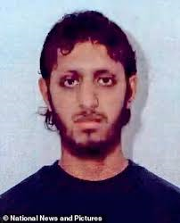
London Bridge 29th November 2019
Nazam Hussain
Usman Khan

Slide 8
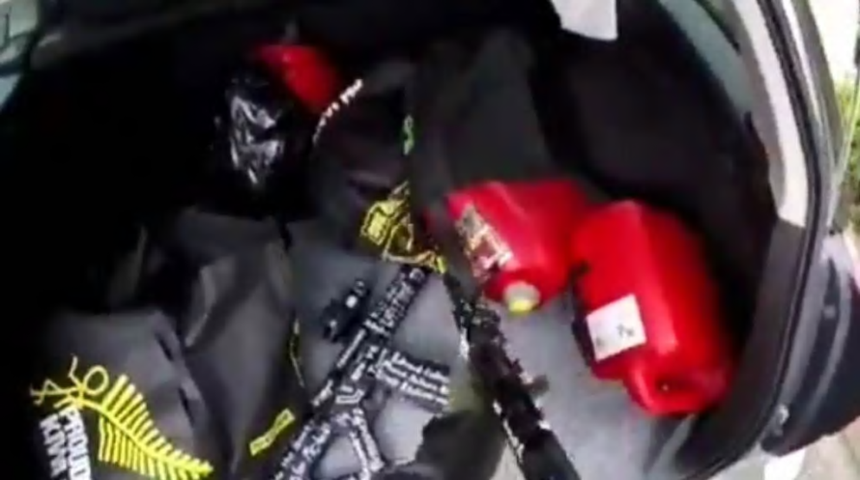
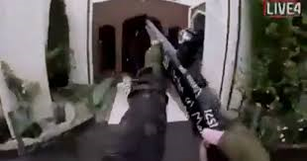
CHRISTCHURCH 15th March 2019
A 28 yr. old Australian man drove to Al Noor Mosque in Riccarton. This male was later named as Brenton Tarrant. He was live streaming his preparation for the attack, and can be seen selecting his weapons from the boot of his car.
He then walks to the door of the mosque before opening fire on innocent people using the mosque.

Slide 9
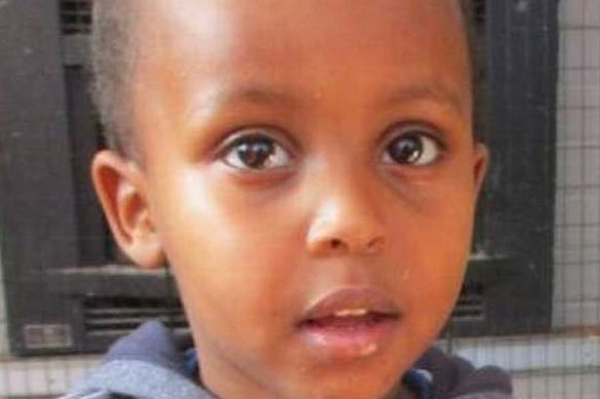
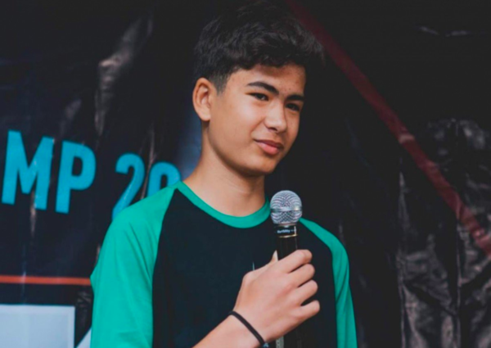
The attacker the leaves the mosque before leaving for the Linwood Islamic centre, where he ones again opens fire on innocent people.
Casualties-
42 people killed at Al Noor Mosque.
7 people at Linwood Islamic Centre
1 person dies later that day in hospital as a result of the injuries.
Mucaad Ibrahim - 3
Sayyad Ahmad Milne - 14

Slide 10
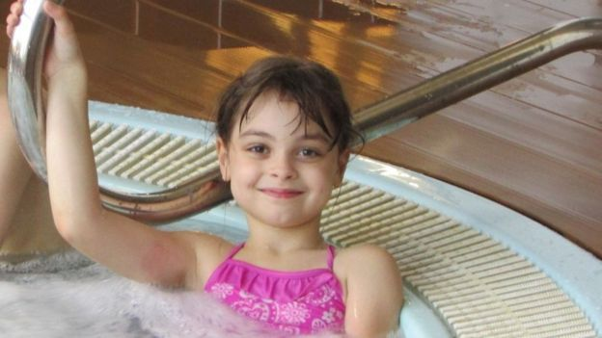
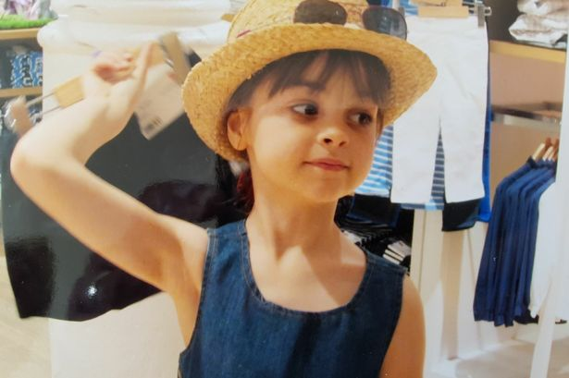
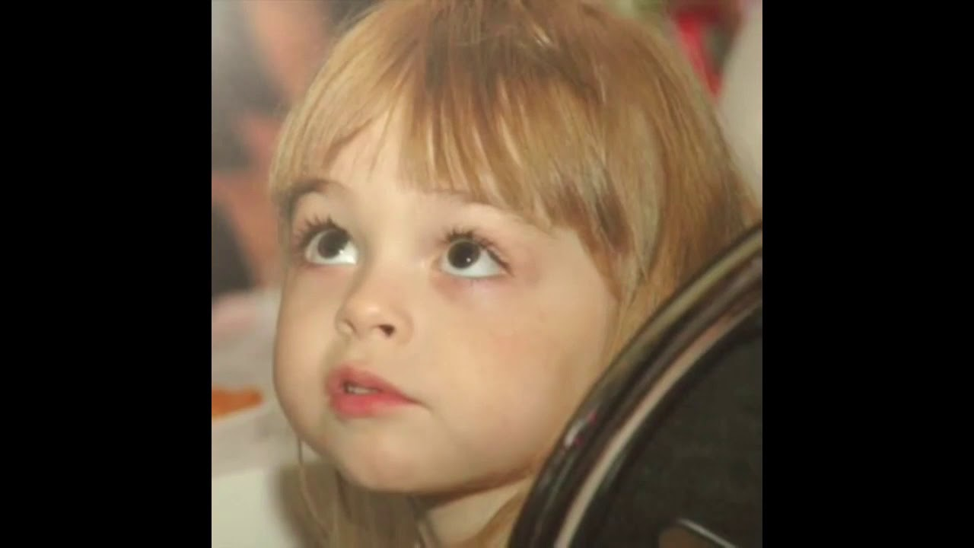
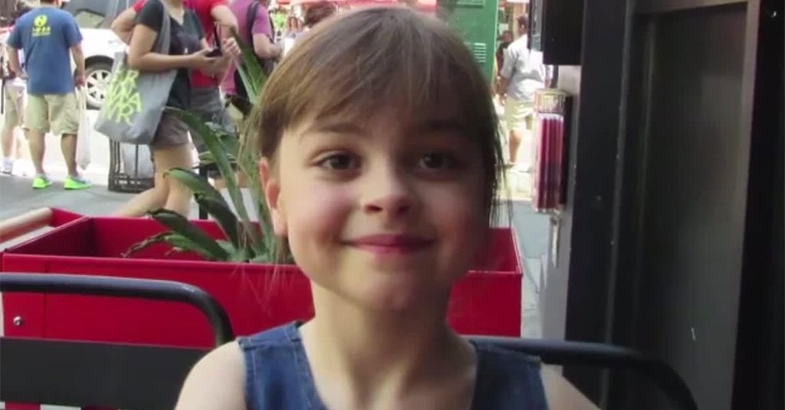
22ND MAY 2017
= 22 people killed
=one of the victims was 8 year old Saffie Rose

Slide 11
PREVENT
Engaging all communities to safeguard children and vulnerable people from Radicalisation
PUSH
PULL
Some factors make people more vulnerable to radicalisation:
Some factors are used to make extremism sound appealing:
- Searching for identity
- Discrimination
- Persecution
- Alienation
- Inequalities
- Perceived global injustice
- Unemployment
- Lack of social amenities
- Grievances
- Friends
- Protection
- A sense of purpose
- On or offline recruiters promising
- outlets for grievances
- Desire for adventure
- Peer groups
- Belonging
- A feeling of achievement
Contact:
Niall.Markham@Walsall.gov.uk
01922 654499
Mob. 07766160646
David.Chadwick@Walsall.gov.uk
01922 652726
Mob. 07584381613
For further advice and guidance visit;
educateagainsthate.com

Slide 12
CONTEXTUAL FACTORS AND SIGNS
Contextual factors that can indicate signs of radicalisation.
Sudden break with the family and long-standing friendships.
Sudden drop-out of school and conflicts with the school.
Change in behaviour relating to food, clothing, language or finances.
Changes in attitudes and behaviour towards others: antisocial comments, rejection of authority, refusal to interact socially, signs of withdrawal and isolation.
Regular viewing of internet sites and participation in social media networks that condone radical or extremist views.
Reference to apocalyptic and conspiracy theories.
Unwilling to consider other points of view
It is important to remember that some signs will be clearer than others, and some less obvious
SIGNS

Slide 13
WHAT DOES IT LOOK LIKE?
Emotional
Verbal
Physical
Short tempered
Be irritable or fussy or have difficulty calming down
Become easily startled
Withdrawn
Fear of being alone
Fixated on a subject
Closed to new ideas
Change in language
Repeat events over and over in play or conversation
No longer sitting with friends
Resort to behaviors common to being younger (thumb sucking, bed wetting, or fear of the dark)
Have frequent tantrums
Absent
Experience changes in level of activity
Become passive and lose interest in playing
Tired
Sudden changes
patterns of behaviour

Slide 14
WARNING SIGNS?
= Sympathising with Extremist ideologies, or justifying their actions.
= Argumentative or unwilling to listen to others points of view.
= Negative comments towards a particular religion or race.
= Changes to friendship groups or appearance
= Talking about extreme content that they have seen on TV
= Specific tattoos or drawing numbers/symbols such as the numbers 18, 318, 14, 88 or symbols such as a swastika or SS bolts.
= Comments about family members/friends that have come returned from abroad.

Slide 15
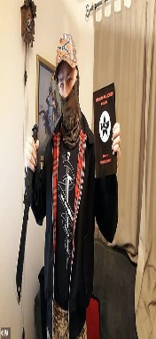
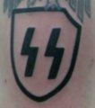
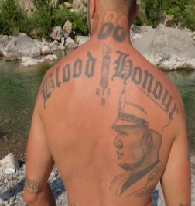
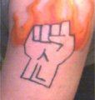
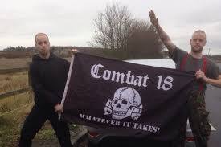
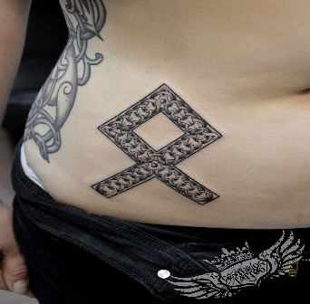
HATE SYMBOLS
Celtic Cross
Used by neo-Nazis, racist skinheads, KKK members and virtually every other type of white supremacist
SS Bolts
Most white supremacists use it in its
Nazi form, as two bolt-like images with flattened ends.
Ayrian fist
The Aryan Fist symbol is a white supremacist symbol
old Othala rune
Being used to replace the swastika to put a friendlier face on fascism

Slide 16
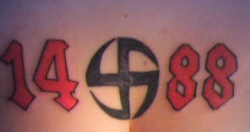
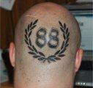
SECRET CODES
Refers to a phrase from David Lane “We must
secure the existence of our people and a future for
White children.
14 -
88 -
Heil Hitler
18 -
Adolf Hitler or C18 - Combat 18
28 -
Blood and Honour
100% -
100% white

Slide 17
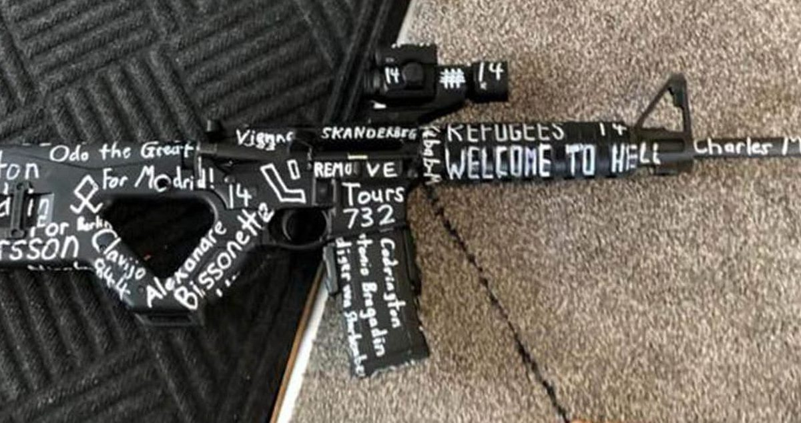

Slide 18
SECRET CODES
The KKK emblem has evolved over time and is now better recognised as a single red swirl, as seen here…
1 and 4 = 14 followed by 5 + 3 = 8 to signify 88 Heil Hitler
Far right extremists use graves to signal to others that they are extremists. Often further adding the initials of prominent white supremacists, such as seen here with Robert Jay Matthews, a Neo Nazi.

Slide 19
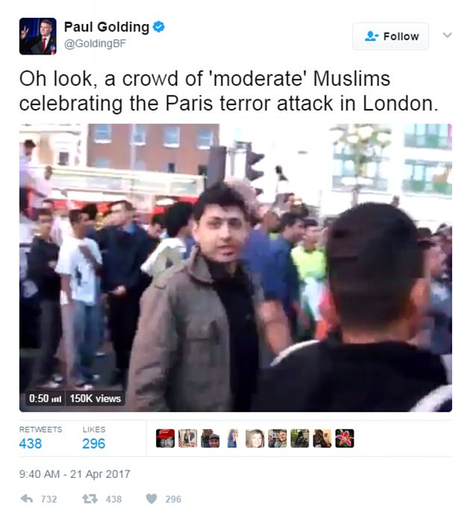
SILENT RECRUITMENT
Far-right groups have become increasingly sophisticated in using social media to recruit and radicalise young people, predominantly young and vulnerable white men. Website forums and far-right pages on social media are breeding grounds for far-right recruiters, where they can chat with unsuspecting teenagers and confused individuals.
Tapping into global instability and genuine concerns over the rise of Islamist extremism, these groups promote anti-Muslim hatred, backed by fake news and distorted facts to increase their influence both online and offline.
This picture is actually a cricket celebration after Pakistan beat Sri Lanka

Slide 20
POPULAR, BUT LESS WELL KNOWN SOCIAL NETWORKING SITES FOR HATE SPEECH AND EXTREMISM
GAB – Social media website that bills its self as a ‘Free speech’ alternative to other social networking sites such as Facebook and Twitter. It primarily attracts Far-right and alt-right users who have been banned from other sites. Robert Bowers (Pittsburgh Synagogue Shooting) posted a message on GAB indicating an immediate intent to do harm shortly before the shooting
4CHAN- a message and imageboard website that was originally started by a Japanese website devoted to anime and manga and subcultures devoted to those artforms. It quickly became popular, and expanded to include many other topics. Then a new group turned up (White supremacists) and started to use the website for political ends.
8CHAN- an imageboard website (similar to 4CHAN) composed of user created message boards. Brenton Tarrant (NZL Mosque shootings) shared a live link to the shootings and his manifesto on 8CHAN minutes before it happened. The Poway Synagogue shooter (California) posted links to his open letter, and attempted to post a live link on 8CHAN before committing the shootings. He also named 8CHAN as a place of radicalisation for him.
TELEGRAM APP- an encrypted messaging service. ISIS uses Telegram as its primary App for media releases.
DISCORD- a messenger application for gamers with more than 130 million registered users. The platform organizes its chat communities into “servers,” each of which contains numerous text and voice channels. One Discord server includes users with pro-ISIS names. The server has featured official ISIS media, Telegram links, and commentary about the group’s operations and strategy. These activities—seemingly casual discussions, the exchange of links and usernames, and the sharing of propaganda and amateurish artwork—are exactly how recruitment takes place.
Notes:
The two main things that all four of these platforms have in common:
ANNONYMITY
NO ACCOUNTABILITY

Slide 21
GENERATION IDENTITY
white supremacist ‘Identitarian Movement’ which started in France
Officially launched their UK Branch last November by dropping a banner from Westminster bridge reading ‘Defend London-stop Islamisation
They seek to recruit ‘young, normal, educated’ people
Claim to represent ‘Indigenous Europeans’ and propagates the far -right conspiracy theories that white people are becoming a minority in what it calls ‘The Great Replacement’

Slide 22
0126
Describing themselves as an anonymous international network of activists, They create accessible and easily printable material encouraging others to spread their rhetoric by posting it in public places. All of their material is easily recognisable as it has a 4 digit number in the upper right corner and the words hundred handers written along the left edge.
HUNDRED-HANDERS

Slide 23
WHAT HAPPENS IF I HAVE CONCERNS ABOUT A PUPIL?
Complete Concern Form and speak with the safeguarding lead at school
If there is significant cause for concern, the safeguarding lead will refer to MASH (via MARF form).
MASH
will refer to Channel.
A multi-agency, Channel Panel will be convened to devise a bespoke action plan for the pupil in partnership with the school

Slide 24
THE LOCAL CHANNEL PROGRAMME
A multi-agency referral process which provides support for those who may be vulnerable from being drawn into terrorism
The Channel panel is chaired and hosted by the local authority.
(1) Confidential and (2) Voluntary
Types of Support
Diversionary activity
Sports participation
Faith Groups
Education support
Housing
Skills training
Mentorship
Employment support
Theological/ Political
Referral Process
Referral is received
Information gathered by local authority
Multi-agency discussion panel
Risk assessment carried out
Voluntary intervention
Post intervention assessment

Slide 25
CHANNEL SUPPORT PACKAGES CAN INCLUDE…
LIFE SKILLS
FAMILY SUPPORT
work on life skills or social skills generally, such as dealing with peer pressure
activities aimed at supporting family and personal relationships, including formal parenting programmes
MENTORING
HEALTH
work with a suitable adult as a role model or providing personal guidance, including guidance addressing extremist ideologies
work aimed at assessing or addressing any physical or mental health issues
ANGER MANAGEMENT
HOUSING SUPPORT
formal or informal work dealing with anger
Support with housing needs
COGNITIVE BEHAVIOURAL THERAPY
DRUGS AND ALCOHOL SUPPORT
cognitive behavioural therapies and general work on attitudes and behaviours
substance misuse interventions
LEISURE
CAREER SUPPORT
supervised or managed constructive leisure activities
activities focused on employment
EDUCATION
Support with Education or skills training

Slide 26
Dave Chadwick Tel no -07584 381 613 or 01922 652726 David.Chadwick@Walsall.gov.uk LinkedIn - davidchadwick1980 Twitter - dchadwick1980

Slide 27
OFSTED INSPECTIONS.

Slide 28
1. Inspection around Radicalisation & Extremism;
Inspectors will be looking for an “understanding of the culture of safeguarding in schools, including Prevent. They will be looking that Prevent fits into the “big picture”. How this culture fits into the Ofsted guidance (headline guidance) - this is guidance only, other things are taken into account.
They are looking for staff to be skilled and confident enough to lead discussions in this area, how are young people’s issues discussed?
Are there wider opportunities in the curriculum to discuss controversial issues taken? Is there for example a debating or discussion society or club?
2. Where does Prevent fit?
Prevent fits in with Leadership and Management; it is the last point of 141 in the Schools Inspection handbook.
3. What if there are concerns for a schools duty under Prevent?
You may raise a concern around a schools commitment to the duty at any time, under due diligence.

Slide 29
4. What type of training is preferable to Ofsted? WRAP is preferable, but they are looking for high quality training in all areas. Generally, throughout the meeting the Ofsted representative was cautious against leaning towards or expressing preferences, when asked if they had a checklist of what they consider best practice, they stated that they do not. It is suggested that schools have due diligence on anyone who is delivering training. How are the school upskilling or equipping teachers to deal with safeguarding or personal issues from pupils? 5. School Governors. What do the Governors know about Prevent? What training have they had? The Safeguarding Governor should be involved in all training around Prevent and Safeguarding training in general.

Slide 30
6. Internet Safety & Policies. Inspectors would look for an internet safety policy, along with evidence of this policy in action. Other policies to ensure are in place: a) Visitor b) Use of Premises by visitors Inspectors will be looking for explanations from staff on how the policies work in practice, what do they actually mean? how are they implemented? There is not a requirement for a separate Prevent policy; however it must be mentioned and included in the Safeguarding policy. There is also no requirement for a separate Prevent action plan, if Prevent in built into the schools wider improvement/action plan. 7. Questioning of staff. Staff should be able to confidently answer questions based around- “What would you do if…?” “How do you know it’s the right thing to do?”

Slide 31
Likely questions
‘What would you do if you had concerns about a young person being drawn into violent extremism?’ – Report to DSL
‘How do you know this is the right course of action?’ – Because it’s a safeguarding issue
‘What are fundamental British values?’- democracy, rule of law, individual liberty, mutual respect and tolerance of different faiths and beliefs.
‘How is your school promoting fundamental British values?’ – worth considering what Ofsted refer to as the formal and informal curriculum. In some schools students have been asked about what they understand by British values·
One which came up really recently was ‘Do you have a Prevent risk assessment?’. This was not in reference to an individual student or concern but was more about the school as a whole. This would be covered by a Prevent checklist but with any info about issues that have arisen in a particular institution or area.

